Slide 1
Gaussian Blur Different Parallel Platforms Comparison
Group No. 24
0756031 資工所 李鴻暘
0416324 資工系 胡安鳳
0416024 資工系 陳羿豐

Slide 2
Outline
What is Gaussian Blur.
Motivation and platform
Environment
Benchmark method
Different platforms explained and respective discoveries .
CUDA
OpenCL
OpenMP
Demo video.
Q&A

Slide 3
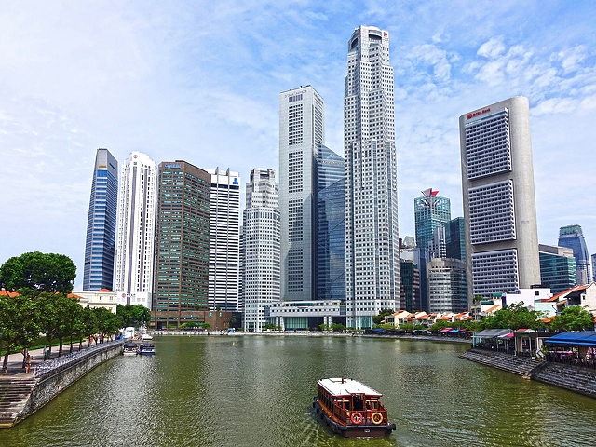

What is Gaussian Blur and why need?
An image processing algorithm using convolution to smooth images.
Can be used for noise reduction of the image.

Slide 4

Blurred effect vs filter size
5 x 5 filter
101 x 101 filter

Slide 5
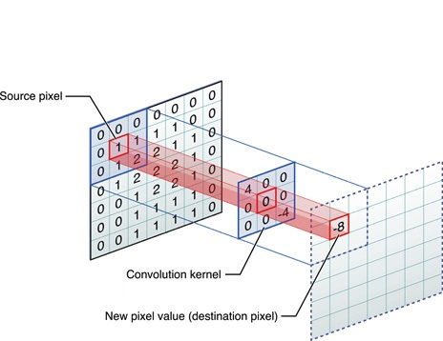
Motivation of this project
Widely used algorithm in lots of software like PhotoShop, GIMP.
Time complexity : O(img_width x img_height x filter_size^2), huge!
Gaussian Convolution with its kernel
Img from Apple Dev.

Slide 6
Parallel Platforms
OpenMP
Pthread
CUDA
OpenCL
CPU Only
CPU + GPU

Slide 7
How we parallel (animation)

Slide 8
Environment for this project
CPU | Intel i5 7500 (4C 4T)
GPU | NVIDIA GTX1070 (1920 CUDA Cores)
SSD | Samsung PM981 SSD 512GB
RAM | DDR4 2666 8G x 4
OS | Ubuntu 16.04 64bit

Slide 9

Benchmark method
8K(7680 x 4320) image for processing
Filter size fixed to 101 x 101
Computation is 338444697600 (338 billion!)
Check error percent if needed (diff image)
Baseline
Serial time is 82m44s (4964s)
POSIX thread time is

Slide 10
Compute Unified Device Architecture
1024 threads per block
A thread process a pixel.
Total 32400 blocks
7680
4320
Using 1024 threads per block.
Total of 32400 blocks.
Each thread deal with one pixel.
Compare pixel-wise(R G B) to verify the correctness

Slide 11

Result
Serial 4964sec, CUDA 5.875sec, accelerate 857x
Error is 1% but unseen by eye in blurred image.

Slide 12
Threads per block vs performance
Secs
Threads per block

Slide 13

CAN WE DO FASTER?

Slide 14
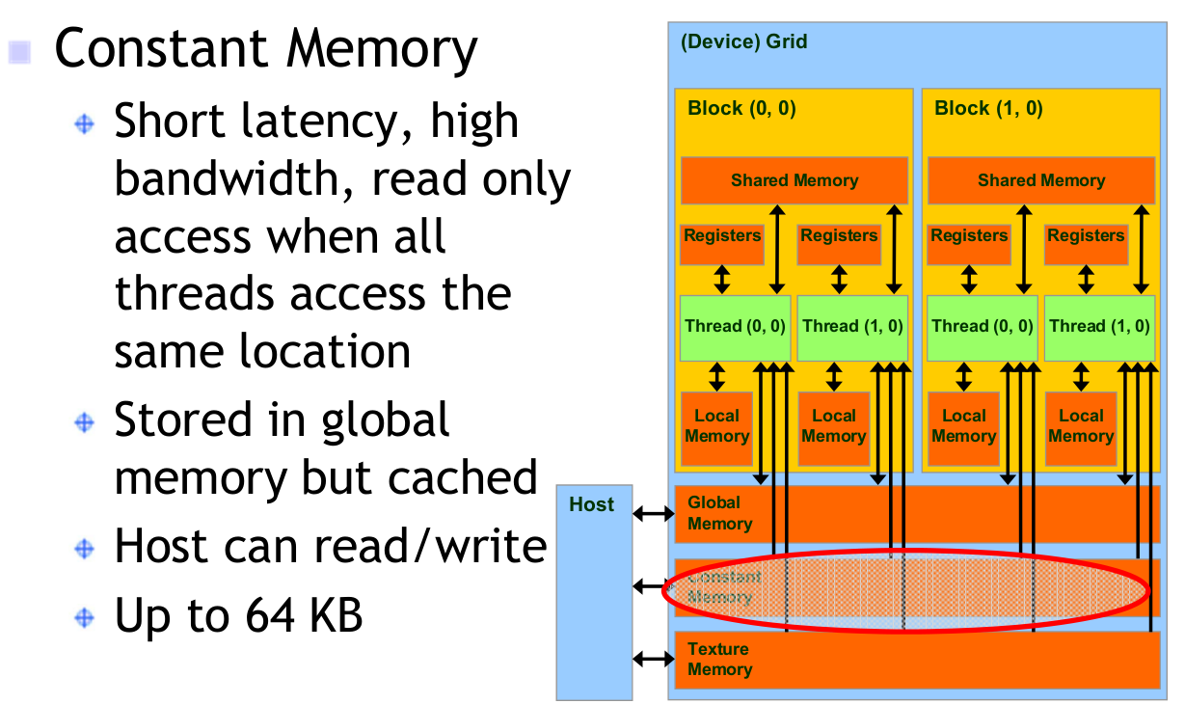
Do faster with Constant Memory
Filter is frequently and repeatedly accessed but GPU global memory is quite slow.

Slide 15
Threads per block vs const performance
32%
Secs
14%
14%
22%
27%
Threads per block

Slide 16
Result with const memory
CUDA const 5.875sec, accelerate 1108x
Identical with normal CUDA, error 1 %

Slide 17
Demo Video

Slide 18
Individual Works
名字 | 負責 | 貢獻度
胡安鳳 | CUDA、PPT、Demo Video Editing、Environment Support
李鴻暘 | OpenCL、PPT
陳羿豐 | OpenMP、Code Suggestions

Slide 19

Q&A

